Slide 1
IBM- Capstone
Daniel Vos

Slide 2
Data
Collected from the municipality
Foursquare API

Slide 3
Methods
Clustering by string
Folium Map visualisations

Slide 4
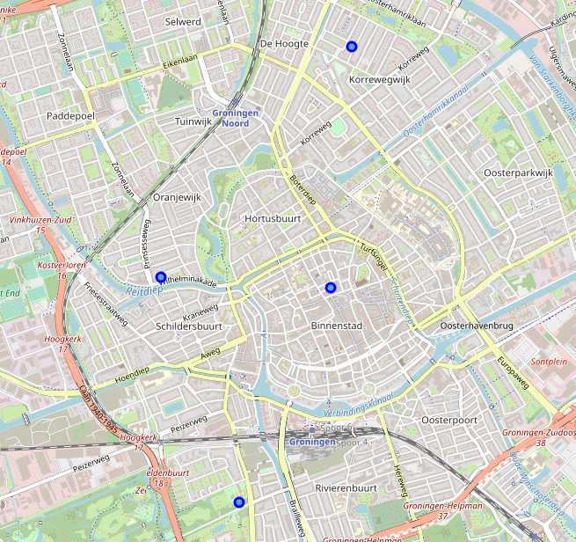
Results
Map
Pin pointing the four main centre neighbourhoods

Slide 5
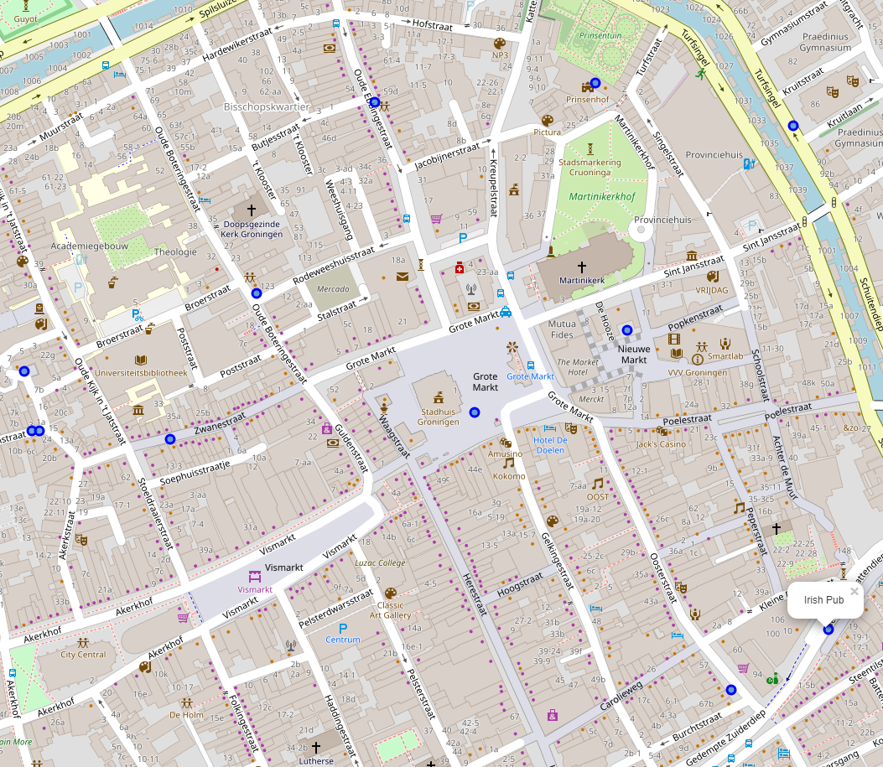
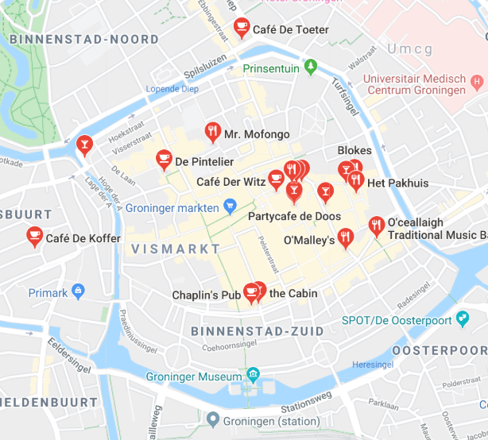
Foursquare data is insufficient
Foursquare bars
Actual Bars

Slide 6
Conclusion
Use a different api in smaller cities
Centre of Groningen is the main spot to locate a bar.
Outside of the centre bars are non existend(according to the api)
When you are in Groningen you will find plenty of bars outside of the city centre.

